Slide 1
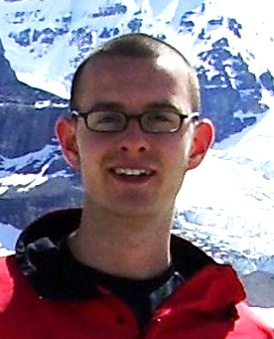


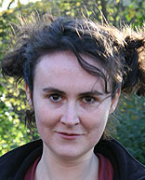

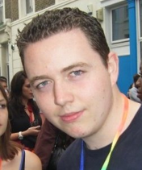

Untangling the tangled bank:
A connectionist view of biological complexity
Richard A. Watson
Natural Systems Group, Southampton.
Rob Mills
Chris Buckley
Simon Powers
Alex Penn
Nic Palmius
James Snowdon
Mike Lewis

Slide 2
A personal view of the evolution of complexity
Coming from models of sex and symbiosis…
The common theme is the tension of evolving ‘parts’ and evolving ‘wholes’
  Genes and building blocks
  Building blocks and genomes
  Individuals and partnerships
  Species and ecosystems
The underlying question is:
  How do complex adapted systems arise from the evolution of self-interested individuals?
Here I present my findings, a personal view of the evolution of complexity

Slide 3
An approach…
Complexity, to a degree, is demanded by the complex environments (interactions with other organisms) in which organisms live, but
My position is that natural selection exhibits a generic trend to make things simpler whenever possible – not more complex
One of the most important ways that things get simpler is by manipulating their environment (‘niche construction’) such that a simple way of life is sufficient (don’t construct a complex solution, if you can simplify the problem)
When a complex interacting mess of many species each acts to simplify their relationships with one another – they collectively create new adaptive structure at a higher level of organisation … (even though they each individually get simpler)

Slide 4
Claims
The manner in which connections between species in an ecosystem change follows organisational principles familiar in computational neuroscience
This means that ecosystems are capable of exhibiting holistic behaviours normally reserved for cognitive systems (memory, adaptation) despite the fact that they are not units of selection
The improved adaptation at the system level is provided by individuals forming groups or ‘teams’ that act in concert (become ‘wired together’). This is fundamentally connected to the creation of new levels of organisation in biological complexity.

Slide 5
The tangled bank
“It is interesting to contemplate a tangled bank, clothed with many plants of many kinds, with birds singing on the bushes, with various insects flitting about, and with worms crawling through the damp earth, and to reflect that these elaborately constructed forms, so different from each other, and dependent upon each other in so complex a manner, have all been produced by laws acting around us. [theory bit]. There is grandeur in this view of life, … from so simple a beginning endless forms most beautiful and most wonderful have been, and are being, evolved.” — Darwin

Slide 6
The theory bit
“These laws, taken in the largest sense, being Growth with Reproduction; Inheritance which is almost implied by reproduction; Variability from the indirect and direct action of the conditions of life and from use and disuse; a Ratio of Increase so high as to lead to a Struggle for Life, and as a consequence to Natural Selection.” (my emphasis)
aka… heritable variation in reproductive success
= ‘natural selection’

Slide 7
Connectionism: From a theory of things to a theory of relationships between things
In the Darwinian account, connections between things
  form the backdrop of organismic evolution;
  they’re complex
  they’re tangled.
  They cant be adapted because ecosystems are not units of selection, species adapt individually (in the context of one another)
In this talk I want to
  present a perspective that brings the connections between things into the foreground,
  show that they exhibit system-level organisational principles without system-level selection (i.e. they’re not just tangled)
  Suggest that understanding structure in ecosystems is essential for understanding origin of organismic complexity

Slide 8
Motivations 1: bio phenomena that are not understood
Evolution of cooperation – makes sense (only) if species are better off when they cooperate than when they defect – but how do they get themselves into situations where it’s not beneficial to defect?
Symbiogenesis: (origin of eukaryotes)
  ...different bacteria form consortia that, under ecological pressures, associate and undergo metabolic and genetic change such that their tightly integrated communities result in individuality at a more complex level of organization. [Margulis, 1995].
Major transitions: (self-replicating molecules → proto cells → prokaryotes → eukaryotes → multi-celled organisms → sexual …)
  entities that were capable of independent replication before the transition can replicate only as part of a larger whole after it. [Maynard-Smith & Szathmary, 1995].
Implications of multi-level adaptation

Slide 9
Motivations 2: evolution of complexity
‘evolutionary algorithms’ embody the necessary and sufficient conditions for natural selection
They don’t produce complexity – if anything, in artificial life experiments (e.g. Ray 1991), things get simpler, not more complex, over evolutionary time.
What’s missing from our understanding of evolution?
Approach: I think its an understanding of how new entities arise from the complex interactions between existing entities.
  By analogy with connectionism in artificial intelligence/ cognitive science
    i.e. the clever part of cognition is not in the neurons but in the organisation of the connections between them
  in evolution, the clever part of adaptation is not in the evolving entities but in the organisation of the relationships between evolving entities.

Slide 10
Outline
Motivations and claims
Connections come out of the shadows
Model and results
A connectionist explanation
Discussion points and Conclusions

Slide 11
Environment as context and product of evolution
The ‘biotic environments’ of organismic evolution are not a static ‘backdrop’ for the evolving unit (species) but a dynamical consequence of the interactions among the units (Lewontin, Odling-Smee)
and the interactions among the units are not static but evolved
  organisms alter connections with other organisms
    Co-evolved fitness dependencies, symbiotic relationships, etc →

Slide 12
‘Social Niche Construction’ (Penn 2006, Powers et al 2009)
Alex Penn
i.e. organisms create their own social contexts that then alters their social behaviours
  organisms change their interaction structure with other organisms
    E.g. habitat pref, preferential attachment/ dispersal, any character that changes probability of interacting with others
  Interaction structure changes distribution of benefits
  → individual selection that changes distribution of benefits appropriately ≡ higher-level selection
Simon Powers

Slide 13
Social niche construction examples
Alex Penn
Individual evolution of characters affecting interaction structure
Bacterial biofilm microcolony structure (in vitro) affects type-1 group selection (Penn et al, in prep)
Interaction coefficients that alter ecosystem attractors (Penn 2006, Lewis 2009)
Group size preference that alters strength of group selection (Powers et al 2007, 2009)
Social markers that implement assortative grouping (Snowdon et al 2009)
Explicit codisperal preferences that effect new units of selection (Mills et al 2009, Watson et al 2009)
Simon Powers
Mike Lewis
Rob Mills
James Snowdon
Nic Palmius

Slide 14
Social Niche Construction
Consider the concurrent evolution of social traits (e.g. cooperate/defect) and niche constructing traits (that affect population structure, e.g. group size):
“any component of selection on a social trait that is due to changes in a niche constructing trait must act in the direction that increases cooperation” (Powers 2010).

Slide 15
Theory needed
We know that the connections/interactions between existing entities define the context for the evolution of those entities – define selective pressures/ the fitness landscape that they ‘see’
We know that the connections are themselves dynamic/evolvable → coevolution, dynamic fitness landscapes
But we need theory to understand the organisational principles of those connections and how they change over evolutionary time – and how those changes alter higher-level adaptedness

Slide 16
Outline
Motivations and claims
Connections come out of the shadows
Model and results
A connectionist explanation
Discussion points and Conclusions

Slide 17
Global adaptation in networks of selfish components:
Emergent associative memory at the system scale
(Watson, Buckley, Mills – Artificial Life, to appear)
Rob Mills
Chris Buckley

Slide 18
Consider natural selection in context
An organism evolves in context of an environment and of other evolving species
Connections are fitness dependencies (e.g. dependence on a shared resource) – and these are evolvable
Can the ecosystem as a whole be adapted?
NS
NS
NS
NS
NS
NS
NS
NS
NS
environment
No – the ecosystem as a whole is not a unit of selection.
Each species acts selfishly – although species can be coadapted to one another, no species has any interest in increasing the fitness of another species (except when it benefits itself).
Notes:
A species, in interaction with others, forms a network
What can we say about the evolution of the whole? (that’s different from the sum of the adaptation of the parts)
Is it the case that whatever happens NS is responsible for the adaptation that results?

Slide 19
Overview of model
Define behaviour of species in an ecosystem (on assumption that relationships cannot change)
  Behaviour of a species, s_{i}, is just a single bit, -1/+1. (cooperate/defect, play strategy-A/strategy-B, tall/short, day/night, high/low{ph/salt/O₂}).
  Interactions with others is defined by a vector of interaction coefficients for each species, α_{i1..N}
2) Then demonstrate how that behaviour changes if relationships are allowed to evolve
  i.e. a vector of evolvable interaction coefficients, β_{i1..N}, that augments the original vector (initially zero)

Slide 20
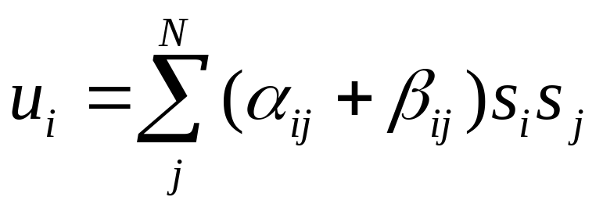
Individually simple (trivial) behaviours of each species + complex interactions → complex ecosystem behaviour
An individual’s fitness is defined by a utility function – a weighted sum of interactions with the behaviours of other agents. Different weightings, some positive, some negative; represents e.g. dependence on same resources
basis of many physical systems (e.g. spin glass, Ising model) and Lotka-Volterra ecological dynamics (growth rate)

Slide 21
Behaviour given these interactions
Each species simply modifies s_{i} to maximise u_{i}
But a change in one species that increases its fitness may decrease the fitness of another…

Slide 22
‘Ecological’ dynamics
Ecosystem settles down to an ‘attractor’ (equilibrium , ESS): a configuration of behaviours where no species wants to change its behaviour unilaterally.
Different equilibria have different total utility (sum of individual fitnesses) – depending on how happy each species is in that biological context.
We’re interested in the total utility of configurations that evolution finds. (attractors are like local optima in total utility)
For random interactions (or other test cases) the maximum possible utility is not found (it has a tiny basin of attraction).

Slide 23
‘ecological’ dynamics
Initialise relationships (random or modular test cases)
Repeat forever
  Pick a species at random
    Let it choose the behavioural state that maximises its fitness
  Infrequently (e.g. with probability τ=0.0001)
    Report total utility.
    Randomise behavioural states.

Slide 24
Evolved connections
Generally ecological models suppose that connections cannot be altered. But, some interaction coefficients can be altered by evolution, of course. E.g. I’ll eat something else/use different resources, change when or where I eat it, and this affects the interaction coefficients between me and other species.
If a species could alter its interactions with other species over evolutionary time, how would it change them?
It must change them to maximise its fitness. i.e. to maximise

Slide 25
Original connections and evolved connections
i.e. Interactions I can’t change and interactions I can change
After evolution of connections, ecological dynamics has same form as before but with different parameters
We’ll continue to measure total utility using only original connections – i.e. how fit are you wrt the constraints you cannot change?

Slide 26
‘ecological’ dynamics plus evolved connections
Initialise relationships (random or modular test cases)
Repeat forever
  Pick a species at random
    Let it choose the behavioural state that maximises its fitness
    Let it modify its interaction coefficients a tiny bit.
  Infrequently (e.g. with probability τ=0.0001)
    Report total utility (measured using original connections only)
    Randomise behavioural states.

Slide 27
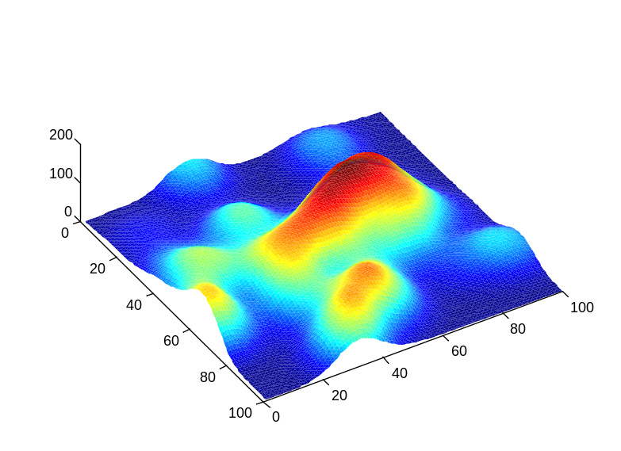
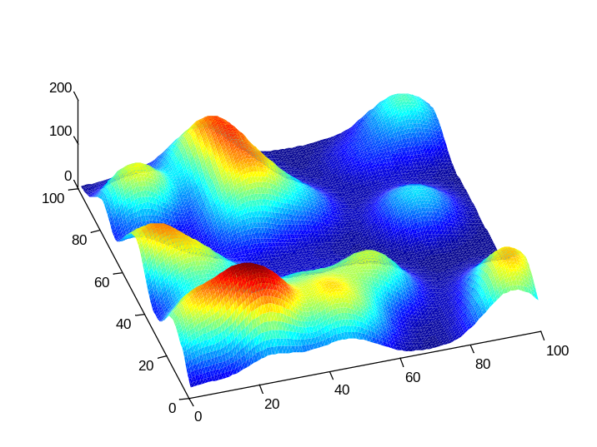
Refined research question
How do changes to network connections carried out by selfish agents (to maximise their individual gains) alter the likelihood that the system visits behavioural attractors that have especially high overall utility ?
Do the new attractors increase or decrease the basin of attraction for configurations that have high overall-utility?

Slide 28
Test cases
Original (immutable) connections are random
  Least assumptions
Original (immutable) connections are modular (and consistent)
  Easier case to analyse (known difficulty)
The simulation returns the total utility of each attractor found – we plot a histogram showing the frequency with which different total-utility values are found. And we see how this distribution changes after sufficient evolutionary time has passed for interactions to change significantly.

Slide 29
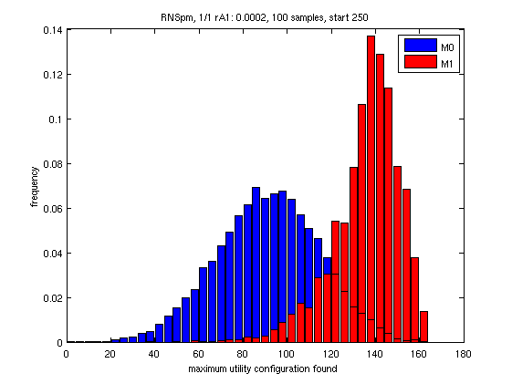
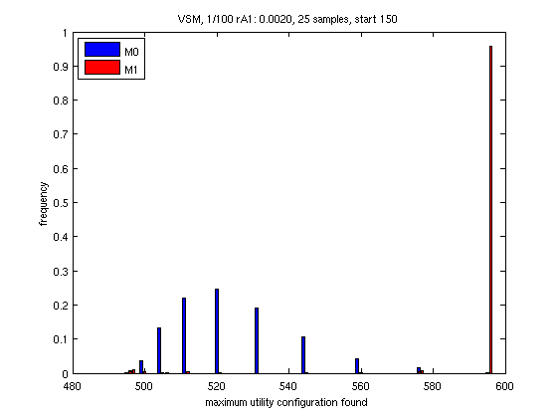
Results
Rob Mills
Initially random connections
Initially modular connections
after
before
total utility of attractors
total utility of attractors
Before: attractors have broad distribution in total utility.
After: new attractors have significantly higher total utility.

Slide 30
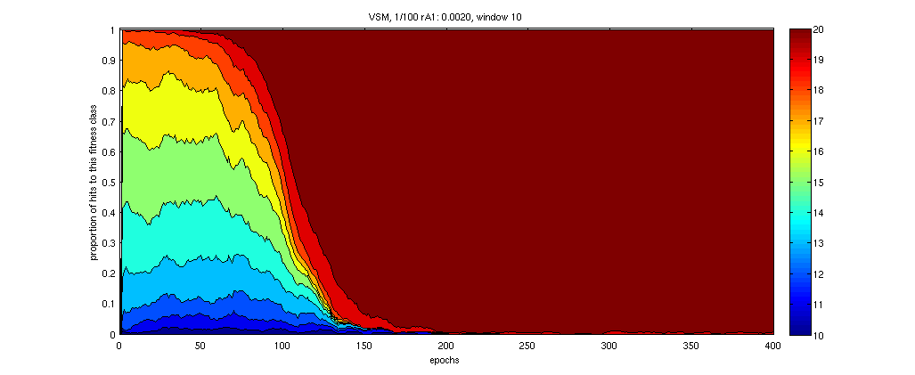
Changes in attractor basins and ‘prediction’
Basin of attraction for global optimum is initially tiny
(Globally optimal configuration is visited for first time >10 times faster with evolved connections)
Basin of highest utility attractor increases from almost nothing to the whole space
proportion of attractor basin
time

Slide 31
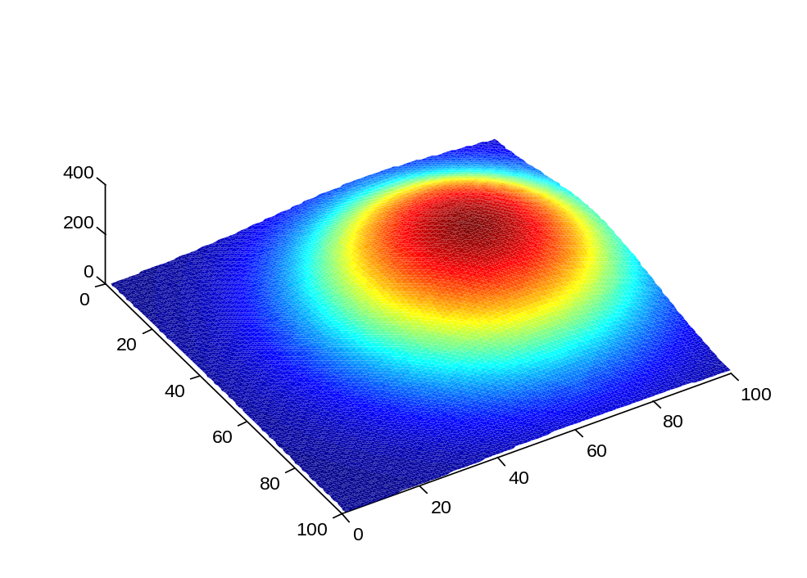
So, how has the ecosystem landscape changed?
The easy-to-find solution of the new problem,
is the hard-to-find solution of the original problem

Slide 32
These results show that
If we allow species to modify their own connections to maximise individual utility then they amplify configurations that have high total utility, in some cases removing all local optima except the global optimum – hence finding a configuration where sum of utilities is maximised / ‘solving’ the global optimisation problem
This only works if we change weights slowly whilst repeatedly relaxing the states to many different local optima
It works even for a network that has initially random connections – i.e. there’s no special assumptions about the problem – and it works more strongly in consistent modular networks

Slide 33
Outline
Motivations and claims
Connections come out of the shadows
Model and results
A connectionist explanation
Discussion points and Conclusions

Slide 34
Metaphor: Consider training a neural network
Trained against a set of training patterns (its environment)
Network exhibits adaptive responses
  Memory/Recall from partial patterns
  Generalisation: Idealised exemplars
  Can also be used to solve optimisation problems
  And, trained to solve them better over time
Train with Hebbian learning
environment
Notes:
We could train a network with Hebbian learning, for example, to ‘recall’ patterns it had seen in the env.
We would say the network had holistic function.

Slide 35
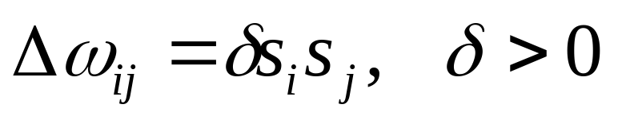
Hebbian learning is distributed Hebb’s rule
A network is trained by Hebb’s rule applied to each connection
It’s a completely distributed training mechanism – a change to a connection is determined solely by the states of the neurons that that connection connects.
σ
HR
HR
σ
HR
σ
HR
σ
HR
HR
HR
σ
HR
HR
HR
σ
σ
HR
σ
HR
environment
Hebb’s rule:
Neurons that fire together wire together
Notes:
But actually we know that Hebbian learning is a completely distributed mechanism.
i.e. Apply Hebb’s rule to each connection.
Note what’s in each node is just non-linear summation – nothing clever there.
The interesting stuff is all in the connections – (but of course you cant tell how clever the connections are except by seeing what they do to the values in the nodes.)

Slide 36
Back to the ecosystem
If species evolve connections with other species in a Hebbian manner, then
All of the dynamical consequences familiar in neural networks would apply to ecosystems…
including a memory of past behaviour and generalisation of training patterns and improved optimisation ability
NS
HR
HR
NS
HR
NS
NS
HR
NS
HR
HR
HR
NS
HR
HR
HR
NS
NS
HR
NS
HR
environment
Notes:
A species, in interaction with others, forms a network
What can we say about the evolution of the whole? (that’s different from the sum of the adaptation of the parts)
Is it the case that whatever happens NS is responsible for the adaptation that results?

Slide 37
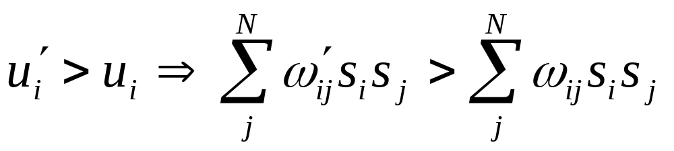
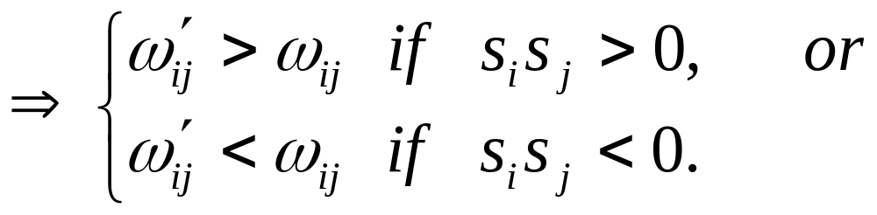
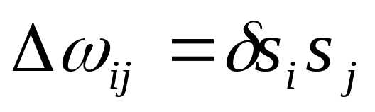
Selfish changes to connections = Hebb’s rule
Selfish update to connections maximise utility
Hebbian changes
with >0
Species that fire together wire together

Slide 38
All this really says is…
Species change connections so that they are happier doing what they’re currently doing (wouldn’t you?... Secret to happiness is to [change] your expectations to the point where they’re already met)
This has the side effect of making them more likely to (recreate a social context in which they) do the same behaviour again in future (creatures of habit)
Dynamically, we say that this increases the basin of attraction for the current configuration… which is exactly what is necessary for Hebb’s rule to create a memory in a neural network
The global dynamical consequences follow from this observation

Slide 39
Outline
Motivations and claims
Connections come out of the shadows
Model and results
A connectionist explanation
Implications and conclusions

Slide 40
Extensions
If individuals can specify co-dispersal preference – think of it as ‘stick together’ - (rather than merely change interaction coefficients) then the co-dispersal preference they specify also follows Hebbian principles
Associative co-dispersal provides properly scalable adaptation…
Nic Palmius
Adam Jackson
Rob Mills

Slide 41
How do I know its not just…
How do I know I’m not just redescribing a trivial process in new language?
Because it can solve optimisation problems that are provably exponential time for ordinary (non-associative) evolution in almost linear time
…

Slide 42
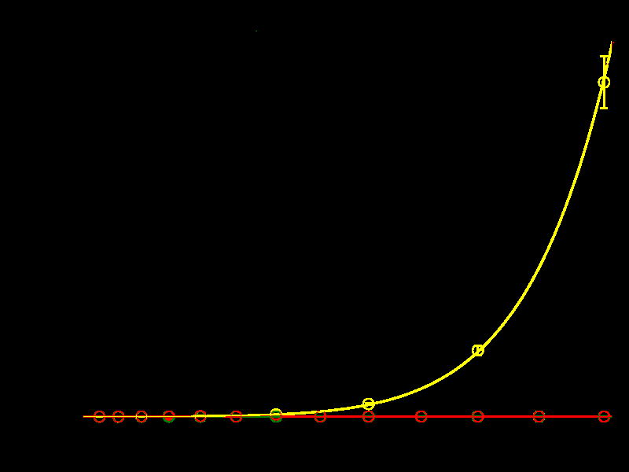
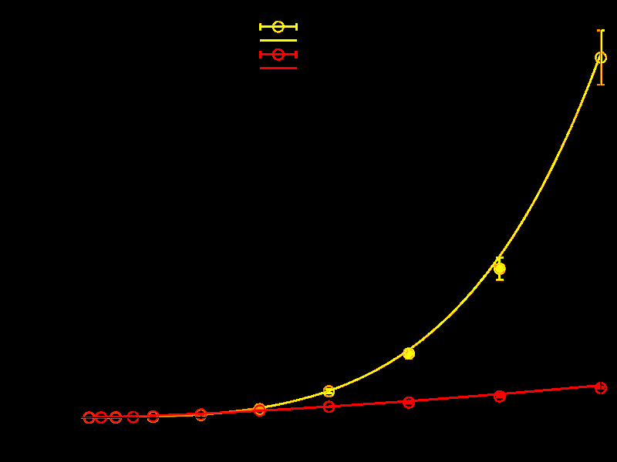
Ordinary evolution rubbish, associative evolution awesome
modular problem
2D Ising model
4.10⁷
3.10⁶
Ordinary evolution
Ordinary evolution
time
time
Associative codispersal
Associative codispersal
0
0
8
problem size
256
16
problem size
400
Very fit complexes evolved quickly and reliably, that would be highly improbable under non-associative evolution. (Mills & Watson 2009)

Slide 43
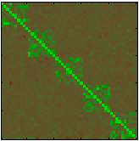
Evolved groups identify intrinsic modules in the problem
species
Evolved associations reveal modularity of fitness dependencies
Data from an individual-based simulation of evolved associations. Each species population summarised in one row.
species
association strength matrix
common components of attractors are ‘canalised’ into groups. i.e. new units. Algorithmically, competition between these units (not individuals and not whole system) is the right level of selection to optimise total utility.

Slide 44
Implications for evolution of complexity
Individuals are only acting to stabilise their environment – dynamics of the system get simpler over time.
But, in so doing, groups of individuals ‘canalise’, and new levels of adaptive organisation become apparent.
species
A group of species effectively becomes a single unit of selection – always co-creating conditions where there is no advantage to defecting ≈ an evolutionary transition has occurred
species
association strength matrix

Slide 45
Further results
Applications in optimisation (assuming Hebbian learning)
  Watson, R. A., Buckley, C. L. and Mills, R. (2010) Optimisation in ‘Self-modelling’ Complex Adaptive Systems. Complexity . (In Press)
  Watson R.A., Mills, M., Buckley, C.L. (submitted) Transformations in the Scale of Behaviour and the Global Optimisation of Constraints in Adaptive Networks.
  Mills, R. (2010) How Micro-Evolution Can Guide Macro-Evolution: Multi-Scale Search via Evolved Modular Variation. PhD thesis, ECS, University of Southampton.
Selfish agents necessarily alter connections in a Hebbian manner
  Watson, R. A., Mills, R. and Buckley, C. L. (2010) Global Adaptation in Networks of Selfish Components: Emergent Associative Memory at the System Scale. Artificial Life . (In Press)
So, any networks of selfish agents that can alter connections with one another, will do so in a Hebbian manner, and will therefore exhibit this kind of system-level adaptation…

Slide 46
All sorts of adaptive networks show same behaviour
Friendships in a social network
  Davies, A.P., Watson, R.A., Mills, R., Buckley, C. L., Noble, J. (2010) If you can't be with the one you love, love the one you’re with: How individual habituation of agent interactions improves global utility. ALIFE XII, 659-666.
Evolved associations between genes
  Watson, R.A., Buckley, C. L., Mills, R., Davies, A.P. (2010) Associative memory in gene regulation networks, ALIFE XII, 194-202.
Evolved species groups in ecosystems
  Watson, R.A., Palmius, N., Mills, R., Powers, S.T., & Penn, A.S. (2009a) Can Selfish Symbioses Effect Higher-level Selection? European Conference on Artificial Life 2009. (in press).
Physical systems with ‘imperfectly elastic springs’
  Watson, Mills, Buckley, Powers, Penn, Davies, Noble, Bullock (2010) Adaptation without Natural Selection (ABSTRACT), ALIFE XII, 80-81

Slide 47
Conclusions
For Darwin the bank is merely tangled: connections change in an unstructured manner. But in fact, the manner in which connections between species in an ecosystem change follows organisational principles familiar in computational neuroscience
This means that ecosystems are capable of exhibiting holistic behaviours normally reserved for cognitive systems (memory, adaptation) despite the fact that they are not units of selection
The improved adaptation at the system level is provided by individuals forming groups or ‘teams’ that act in concert (become ‘wired together’). This is fundamentally connected to the creation of new levels of organisation in biological complexity
When individuals change relationships selfishly, they (co)create population structure that causes them to cooperate more
Competition is the ‘prime mover’ but the winners are those that cooperate best

Slide 48
Thanks to
Rob Mills
Chris Buckley
Ivor Simpson
Nicholas Hayes
Mike Streatfield
Adam Davies
Adam Jackson
Seth Bullock
Jason Noble
Chrisantha Fernando (Sussex University)
David Iclanzan
(Babes-Bolyai University)
Simon Powers
Alex Penn
Nic Palmius
James Snowdon
Mike Lewis

